Slide 1
Wine Quality
By: Sarah Shupe
DSC530

Slide 2
Data
This dataset contains information about the chemical properties and sensory qualities of red and white wines from the north of Portugal. The hypothesis addressed will be that it is possible to predict the quality of wine based on its chemical properties. Found here : https://archive.ics.uci.edu/ml/machine-learning-databases/wine-quality/
The data includes 11 variables (features) that describe the chemical characteristics of the wine, such as alcohol content, acidity, residual sugar, and pH, and one output variable (target) that represents the quality rating of the wine, which ranges from 0 (very bad) to 10 (excellent). The dataset also includes information about the type of wine (red or white).
The goal of this analysis was to predict the quality rating of the wine based on its chemical properties. The variables analyzed were pH, sulfates, alcohol content, residual sugar and fixed acidity.

Slide 3
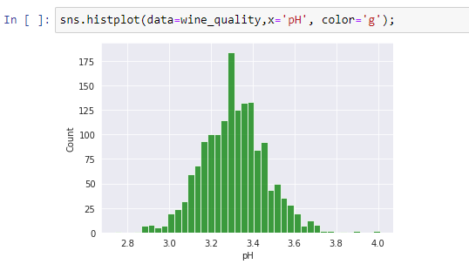
Variable 1: pH
Descriptive Statistics
Mean: 3.3111131957473416
Mode: 3.3
Spread: 0.023835180545412844
Left tail: 2.74
Right tail: 4.01

Slide 4
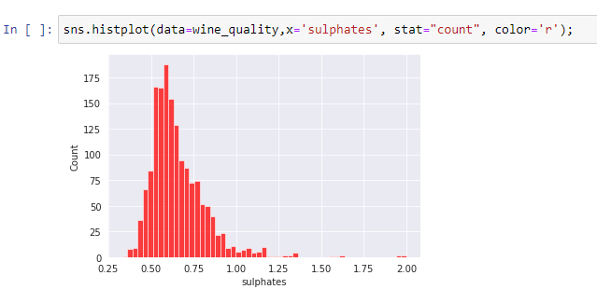
Variable 2: Sulfates
Descriptive Statistics
Mean: 0.6581488430268917
Mode: 0.6
Spread: 0.028732616129761954
Left tail: 0.33
Right tail: 2.0

Slide 5
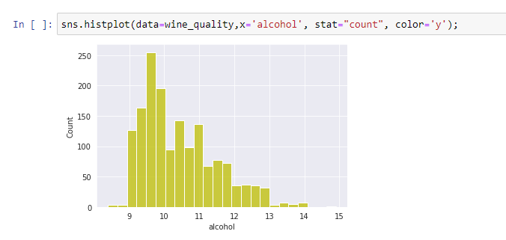
Variable 3: Alcohol Content
Descriptive Statistics
Mean: 10.422983114446529
Mode: 9.5
Spread: 1.1356473950004737
Left tail: 8.4
Right tail: 14.9

Slide 6
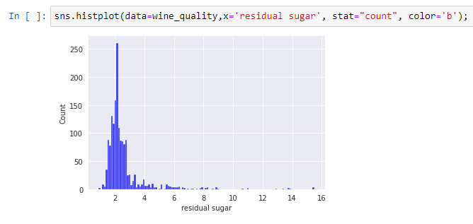
Variable 4: Residual Sugar
Descriptive Statistics
Mean: 2.53880550343965
Mode: 2.0
Spread: 1.9878971329859634
Left tail: 0.9
Right tail: 15.5

Slide 7
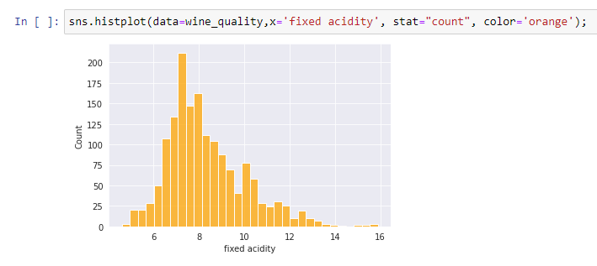
Variable 5: Fixed Acidity
Descriptive Statistics
Mean: 8.31963727329581
Mode: 7.2
Spread: 3.0314163889978167
Left tail: 4.6
Right tail: 15.9

Slide 8
PMF
Let's explore that variable 'alcohol' to see how it relates to high wine quality (wine quality > 5) and low wine quality (wine quality <= 5)
Assuming the distribution of alcohol content is different for high and low quality wines, the PMF plot would show the probability of each alcohol content value for both groups. If the distribution of alcohol content is significantly different between the two groups, you may see distinct peaks in the PMFs for each group.

Slide 9
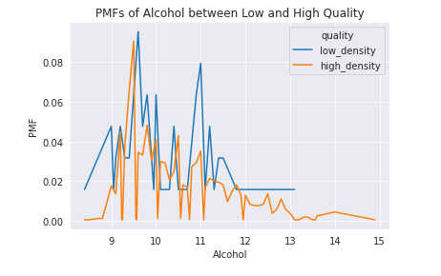
PMF 1

Slide 10
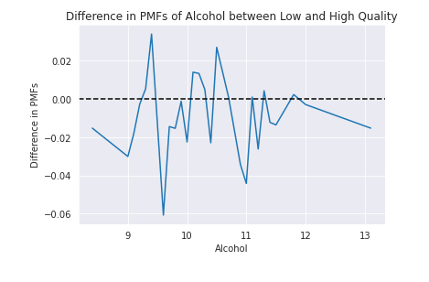
PMF 2

Slide 11
Analysis
The results indicate that alcohol content is not a significant predictor in the quality of wine, since there are examples from each classification across all alcohol contents.
However, it's worth noting that wine quality is influenced by many factors beyond alcohol content, and that the relationship between alcohol content and quality may not be straightforward. Therefore, any conclusions drawn from this analysis should be taken with caution and should be supported by further research and analysis.

Slide 12
CDF and Analytical Plot
For the CDF analysis we will be looking at pH. CDFs are commonly used in statistical analysis and data visualization to understand the distribution of a dataset and make inferences about the probability of certain events or outcomes
For the Analytical analysis we will look at if the CDF has a normal distribution. When a CDF has a normal distribution, it indicates that the data being analyzed is likely to be normally distributed. This can be useful information for statistical analysis, as many statistical tests and models assume normality of the data. Additionally, the mean and standard deviation of the normal distribution can be used to summarize the central tendency and variability of the data, respectively.

Slide 13
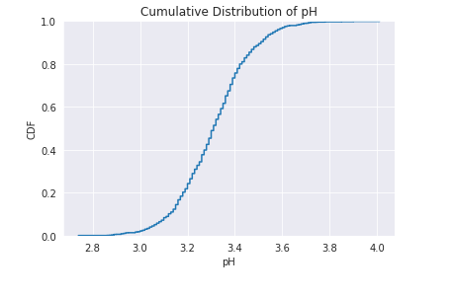
CDF

Slide 14
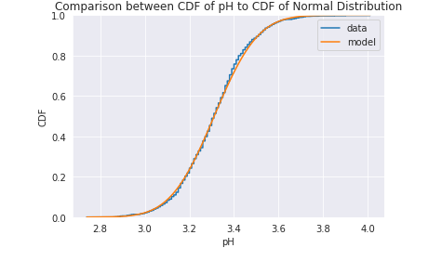
Analytical Distribution

Slide 15
Analysis
The data for pH does appear to be normally distributed, which is a good thing for our data analysis because most test are made to analyze normalized data. A normal distribution is a continuous probability distribution that is symmetric around its mean, with the majority of the data falling close to the mean and fewer data points further away from the mean as you move towards the tails of the distribution. As for the question we are trying to answer, this will allow for our statistical tests to be more reliable.

Slide 16
Correlation and Causation
The variables analyzed for this were pH and wine quality, to see if pH could be used as a predictor of wine quality. The scatter plot graph will help to determine correlation. Each point in a scatter plot represents a pair of values for the two variables being plotted. The position of the point on the graph indicates the values for both variables for a given data point. If there is no correlation, the points will be scattered randomly across the graph.

Slide 17
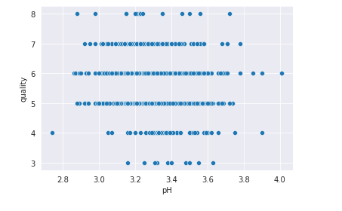
Scatter Plot

Slide 18
Analysis
The graph appears to have random dots scattered across all value pairs, indicating there is not a correlation between pH of the wine and wine quality. The covariance was -0.007193, the Pearson Correlation was -0.057731, and the Spearman Correlation was -0.0436719, all suggesting that there is not a statistically significant relationship.

Slide 19
Hypothesis Test
For this analysis, I hypothesized that the alcohol content would be an indicator as to the quality of the wine, specifically that higher alcohol content would lead to a lower quality wine. To test this and look for correlation, a permutation test was used. The results gave a p-value of 0.12, indicating that it is not statistically significant. Generally, a p-value of 0.05 or smaller is considered to be statistically significant.

Slide 20
Regression Analysis
For the regression analysis, the regression was performed between the dependent variable, fixed_acidity, and explanatory variable, quality. First the least squares fit was calculated. Then the variables were plotted on a scatter plot and the residuals calculated. Analysis of the residuals suggested a non-linear relationship. The R squared value was small indicating that acidity indicates a small part of wine quality.

